Slide 1
QRM – Week 7
Group 15:
M S Karthikeyan
Shivam Bansal
Wu Zheyu

Slide 2
a) Equation Analysis
stateValue(s0,normal,s1)..
v(s0,normal) - 0.796*v(s1,normal)
- 0.0995*v(s1,disrupted) - 0.0995*v(s1,very_disrupted) =G= -4002 ;
Explanation:
If The initial state was normal and the next state is s1, it means a purchase of 100 is being made, which will lead to outgo of 4000(100*40$) + 2(100*.002$)

Slide 3
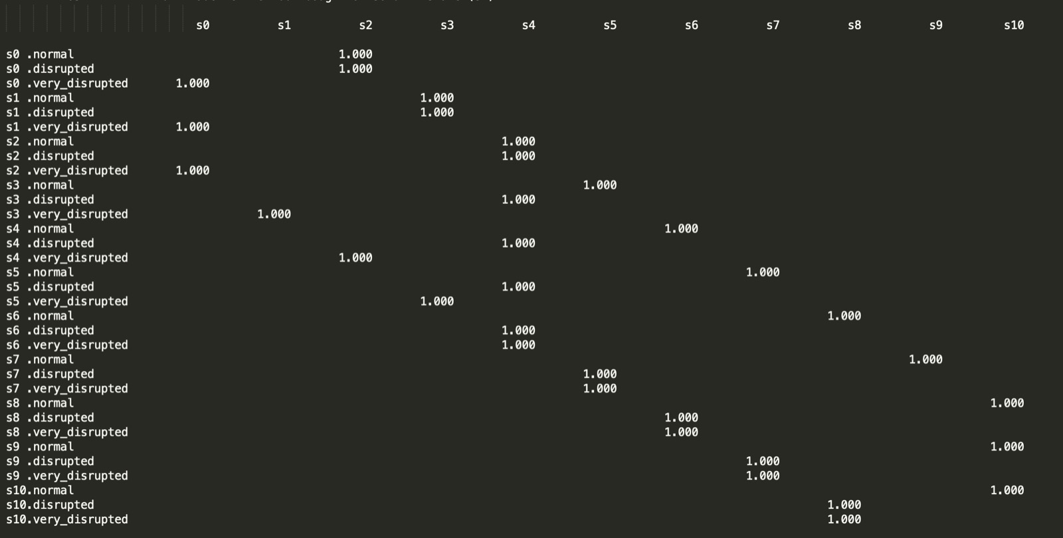
b) i) Optimal Policy
Normal Scenario:
From S0 to S8 the best option is to buy 200 kbbl every month
Disrupted Scenario:
From S0 to S2 the best option is to buy 200kbl as inventory is very low. From S3 to S7 the best option is to retain the inventory as the inventory s moderate. From s7 to S10 the best option is to sell 200 Kbbl as the inventory is very high
Very Disrupted Scenario:
From S0 to S2, no action can be taken. From s3 to s10, the best option is to sell the 200kbbl as the selling price is high and the inventory is also high

Slide 4
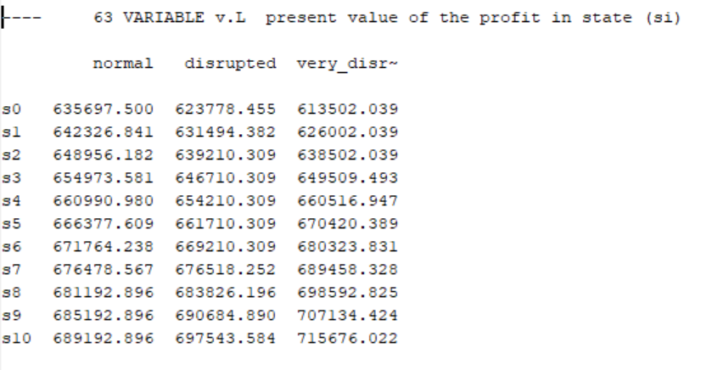
b) ii) Expected Profit
b) iii) Interpretation:
The mimimum profit will be 613502. while the maximum profit will be 715676.

Slide 5
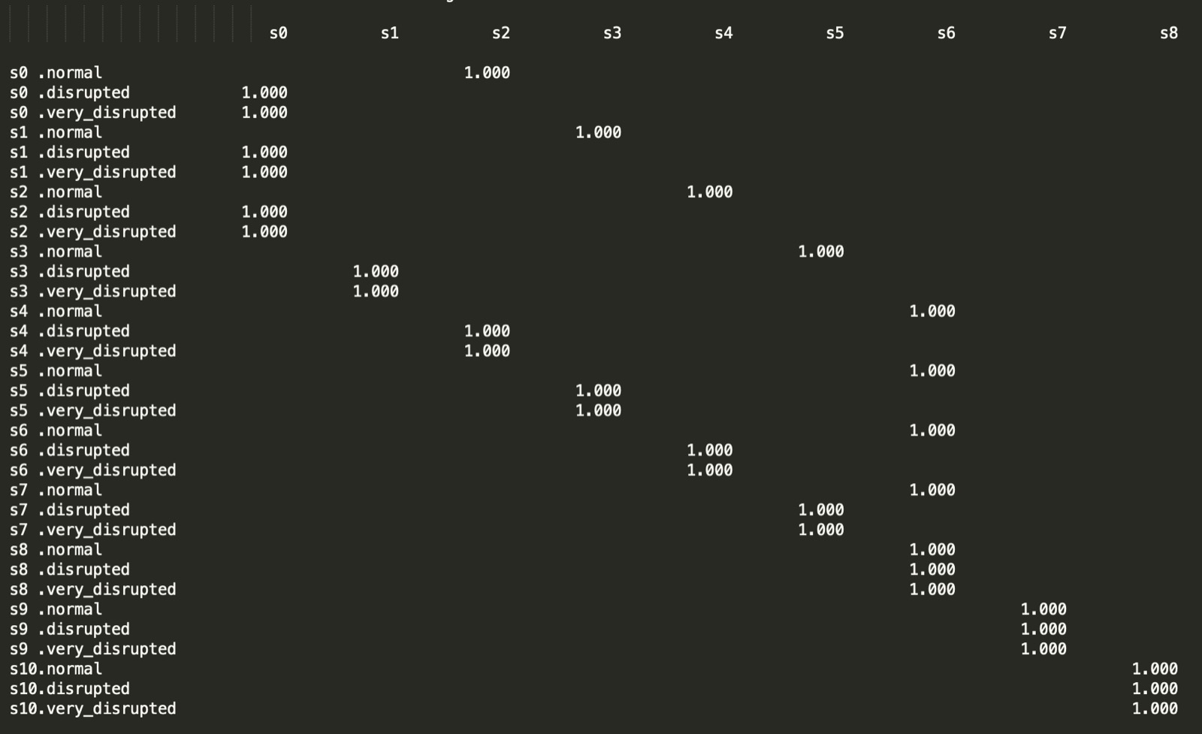
c) i) Optimal Policy – Discount factor -90%
Normal Scenario:
From S0 to S4 the best option is to buy 200 kbbl every month. Since the discount is very high the future value is low that the returns are very low from s5 to s8 it doesn’t make sense to keep high inventory

Slide 6
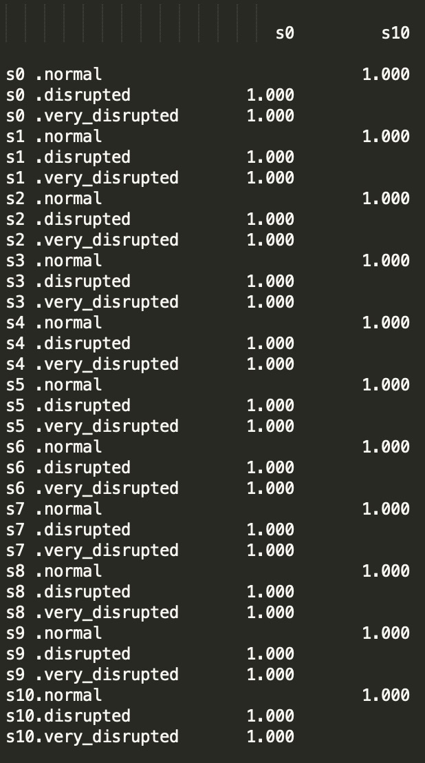
c) ii) Optimal Policy – No Trading Restriction
Normal Scenario:
Since there are no trading restriction, buy maximum whenever its is normal
Disrupted Scenario & Very Disrupted:
Whenever price is high, sell maximum and book the profit

Slide 7
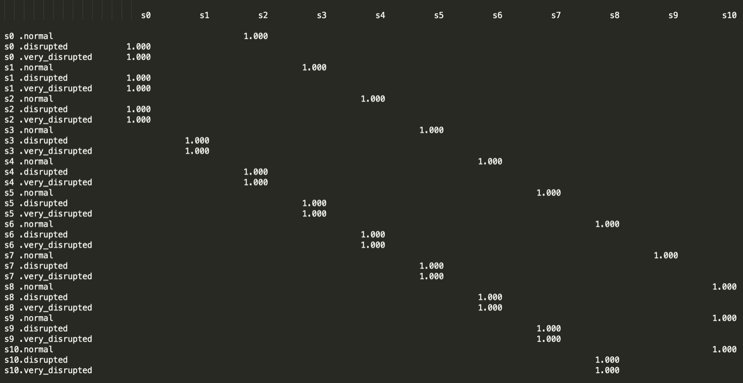
c) iii) Optimal Policy – New Transition Matrix
Normal Scenario:
From S0 to S10 the best option is to buy 200 kbbl every month since the probability of normal is very high
Disrupted Scenario & Very Disrupted Scenario:
From S0 to S10 sell the maximum that can be sold as the probability of normal price is very high

Slide 8
Important Parameters
the restriction on the maximum trading per month is the most important because it limits the max trading restriction which limits the profit

